Slide 1
Chapter 10 Linear Regression

Slide 2
Learning Objectives
Understand the concept of regression .
Understand overfitting and underfitting .
Python and Implement regression using sklearn .

Slide 3
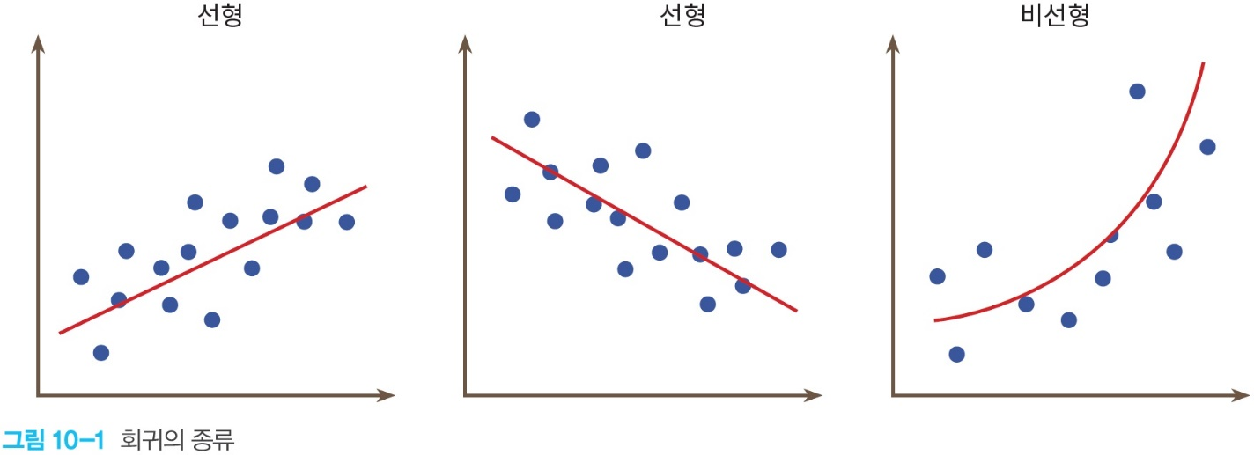
linear regression
Regression is generally the problem of plotting data in a two- dimensional space and finding the straight line or curve that best describes the data .
For y = f(x), regression is predicting a function f(x) when the output y is real and the input x is also real .

Slide 4
Example of Linear Regression
Investigation of the relationship between the height of the parents and the height of the child
House price by area
Prediction of Unemployment Rate by Age
Relationship between study hours and grades
Predict CPU speed and program execution time

Slide 5
Introduction to Linear Regression
Equation of a straight line : f(x) = mx+b
is the problem of finding the slope and intercept values that best describe the input data.
linear Basic expression of regression : f(x) = Wx+b
Gradient -> Weight
intercept -> bias

Slide 6
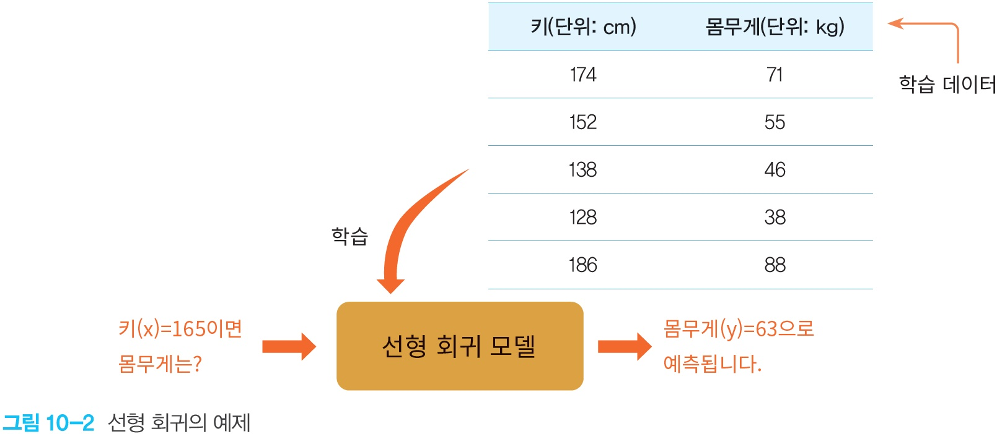
Linear regression example

Slide 7


Types of Linear Regression
Simple Linear Regression : Simple linear regression is a linear regression with one independent variable (x) . w and b are the parameters the algorithm attempts to 'learn' to produce accurate predictions . x and y represent our training data and f(x) represents our prediction .
Multiple Linear Regression : A more complex multiple linear equation is : w 0; w 1 , w 2 , w 3 represent the coefficients or weights and are the parameters the model is trying to learn .

Slide 8
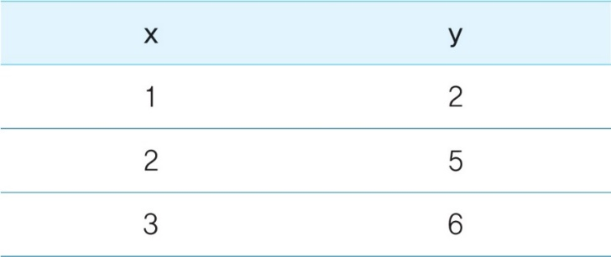

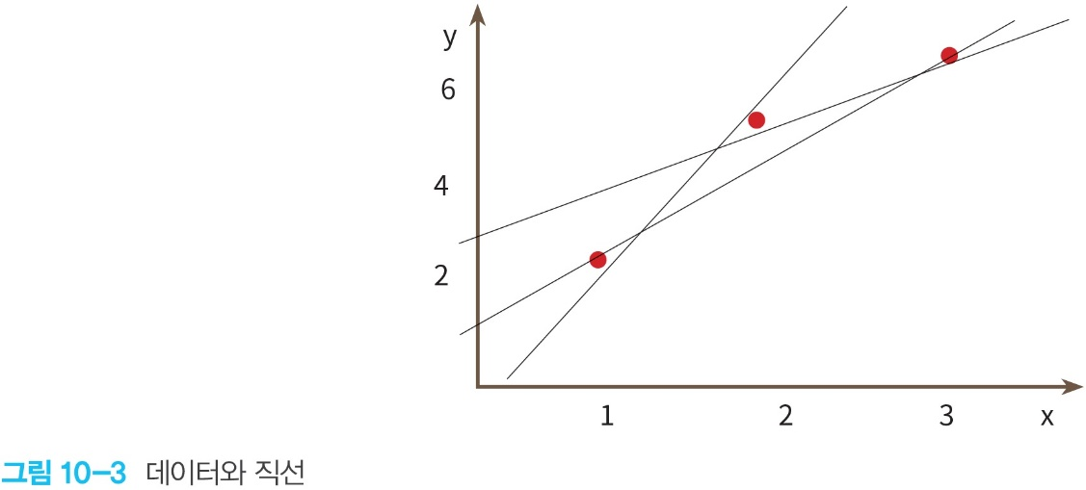
Principles of Linear Regression
data Finding the straight line that best describes it is linear regression .

Slide 9
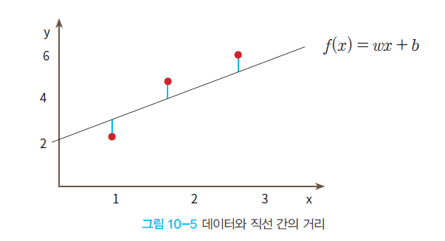
choice of straight line
is which straight line best fits the data we provided . This can be seen by looking at the distance between the actual data and the straight line .

Slide 10
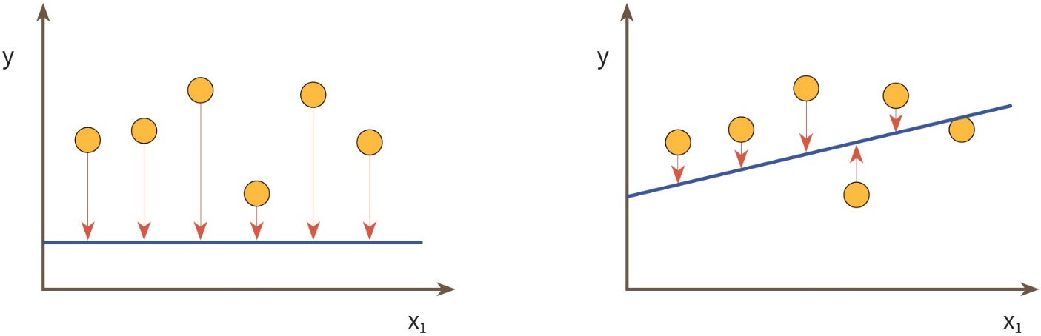
loss function
Closely spaced straight lines describe the data better .

Slide 11

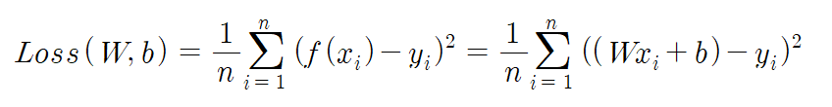
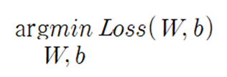
loss function
The sum of the squared intervals between the straight line and the data is called the loss function or cost function .
generalization
what we are looking for

Slide 12
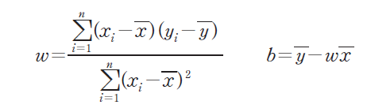
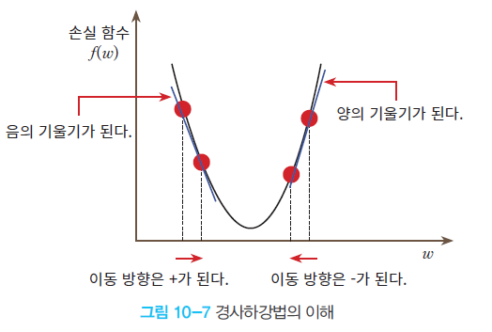
Loss Function Minimization Methods in Linear Regression
Analytical Method : Least Squares Method
gradient descent method
The analytic method is only available for linear regression with one independent variable and one dependent variable .

Slide 13
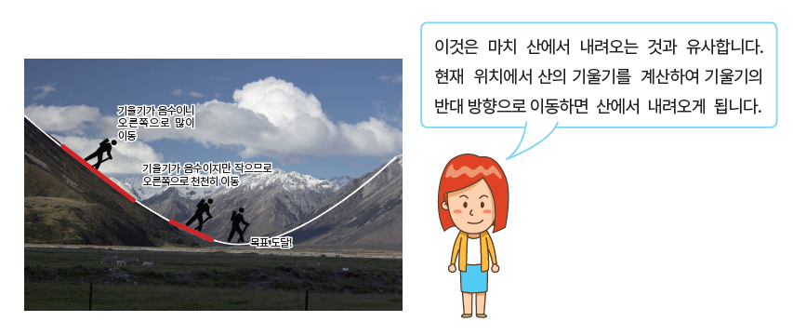
gradient descent

Slide 14
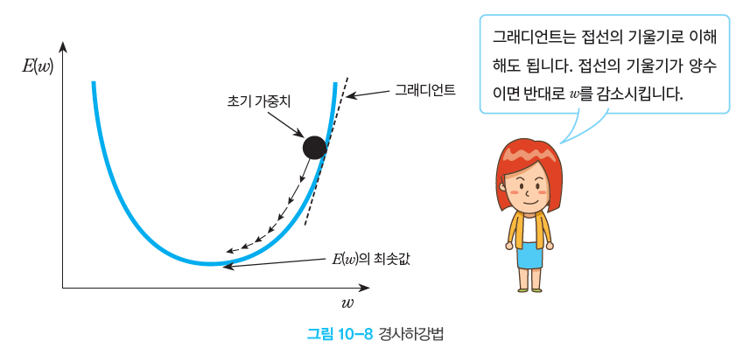
gradient descent

Slide 15
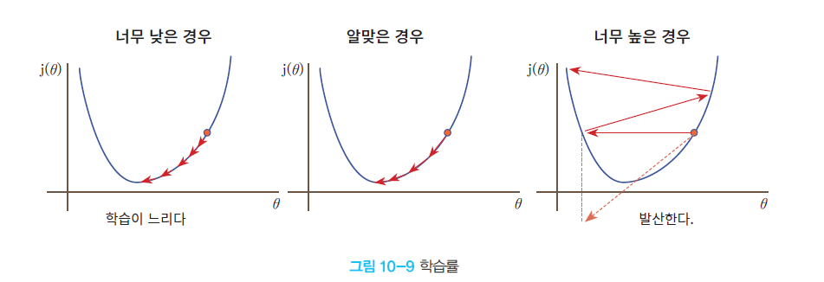
learning rate
The learning rate is the rate at which a parameter is changed at one time .

Slide 16
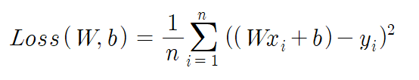
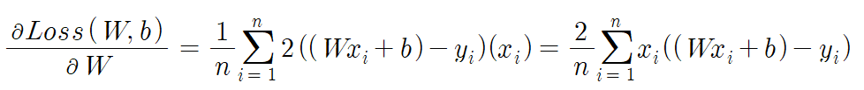
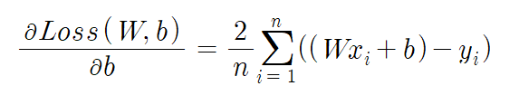
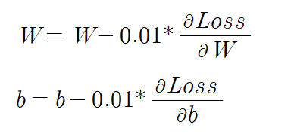
Gradient Descent in Linear Regression

Slide 17
Gradient Descent Implementation
import numpy as np
import matplotlib.pyplot as plt
X = np.array ([ 0.0 , 1.0 , 2.0 ])
y = np.array ([ 3.0 , 3.5 , 5.5 ])
W = 0 # slope
b = 0 # intercept
rate = 0.01 # learning rate
epochs = 1000 # number of iterations
n = float( len (X)) # number of input data
# Gradient Descent
for i in range (epochs):
y_pred = W*X + b # predicted value
dW = ( 2 /n) * sum(X * ( y_pred -y))
db = ( 2 /n) * sum( y_pred -y)
W = W - lrate * dW # Tilt correction
b = b - lrate * db # Modify the intercept

Slide 18
Gradient Descent Implementation
# Print the slope and intercept .
print(W, b)
# Make predictions .
y_pred = W*X + b
# Print the input data on the graph .
plt.scatter (X, y)
# Predicted values are plotted as a line graph .
plt.plot ([min(X), max(X)], [min( y_pred ), max( y_pred )], color = 'red' )
plt.show ()

Slide 19
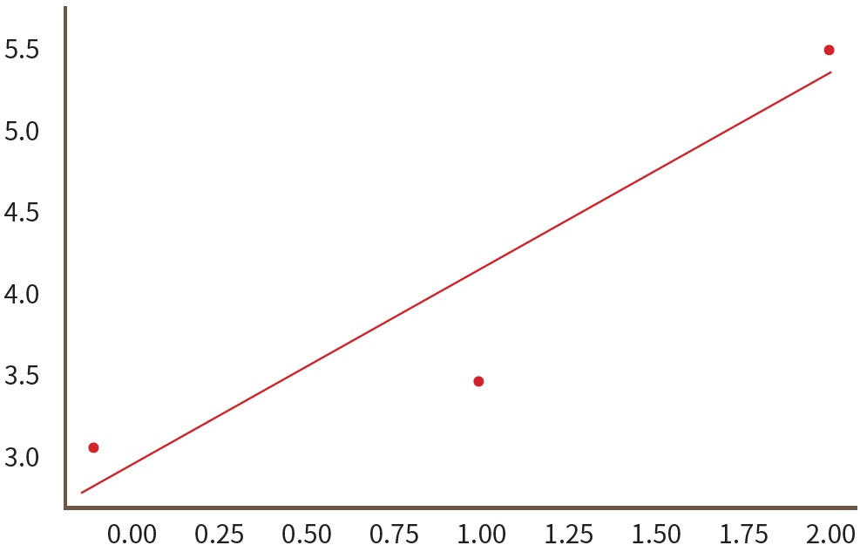
Gradient Descent Implementation

Slide 20
linear Regression implementation #2
, we will see how to implement a regression function using the Scikit -Learn library included in Anaconda .
import matplotlib.pylab as plt
from sklearn import linear_model
# Create a linear regression model .
reg = linear_model.LinearRegression ()
# Data can be a Python list or a NumPy array .
X = [[ 0 ], [ 1 ], [ 2 ]] # Must be 2D .
y = [ 3 , 3.5 , 5.5 ] # y = x + 3
# learn _
reg.fit (X, y)

Slide 21
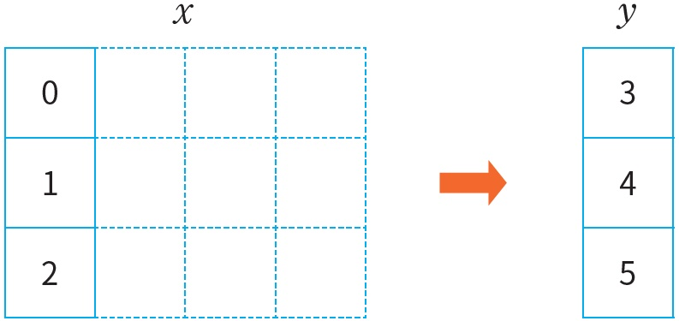
Create training data
Training data must be a two- dimensional array ( even if there is only one column, it must be made in the form of a two- dimensional array ). So, by making a list of lists , we create the following two- dimensional array :

Slide 22
linear regression example
>>> reg.coef _ # slope of the straight line
array([1.25])
>>> reg.intercept _ # y- intercept of the straight line
2.7500000000000004
>>> reg.score (X, y)
0.8928571428571429
>>> reg. predict ([[5]])
array([8.])

Slide 23
Let's draw a graph .
# Plot the training data and y values as a scatter plot .
plt.scatter (X, y, color='black')
# Calculate the predicted value with the training data as input .
y_pred = reg.predict (X)
# with training data and predictions Draw a line graph .
# Draw a straight line with the calculated slope and y- intercept .
plt.plot (X, y_pred , color='blue', linewidth=3)
plt.show ()

Slide 24
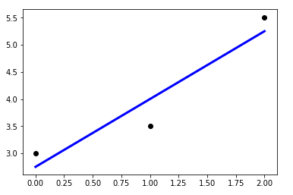
execution result

Slide 25
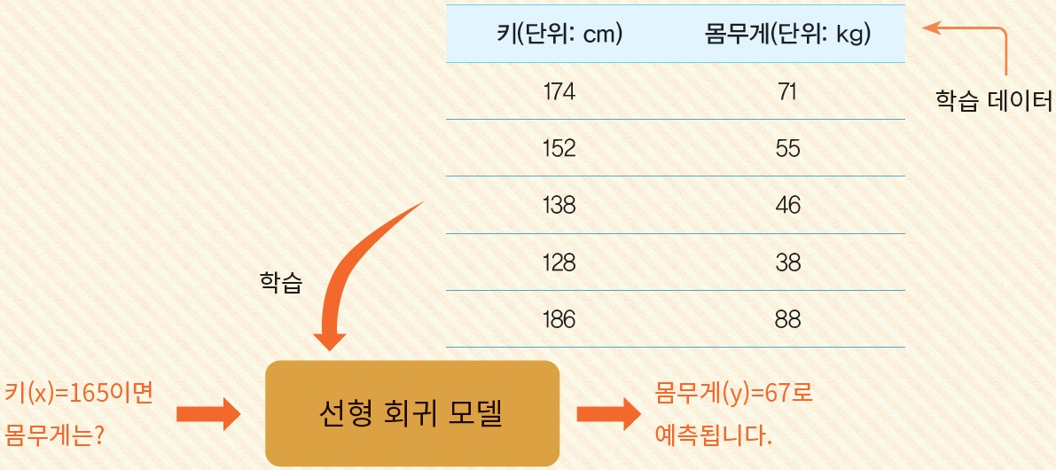
Lab: Linear Regression Lab
Human height and weight are expected to be somewhat proportional . When we have the data below , let's learn it using linear regression and get the predicted value when the height is 165cm . Try implementing it in Python .

Slide 26
linear regression example
import matplotlib.pylab as plt
from sklearn import linear_model
reg = linear_model.LinearRegression ()
X = [[ 174 ], [ 152 ], [ 138 ], [ 128 ], [ 186 ]]
y = [ 71 , 55 , 46 , 38 , 88 ]
reg.fit (X, y) # training
print( reg. predict ([[ 165 ]]))
# Plot the training data and y values as a scatter plot .
plt.scatter (X, y, color = 'black' )
# Calculate the predicted value with the training data as input .
y_pred = reg.predict (X)
# Draw a line graph with training data and predicted values .
# Draw a straight line with the calculated slope and y- intercept .
plt.plot (X, y_pred , color = 'blue' , linewidth = 3 )
plt.show ()

Slide 27
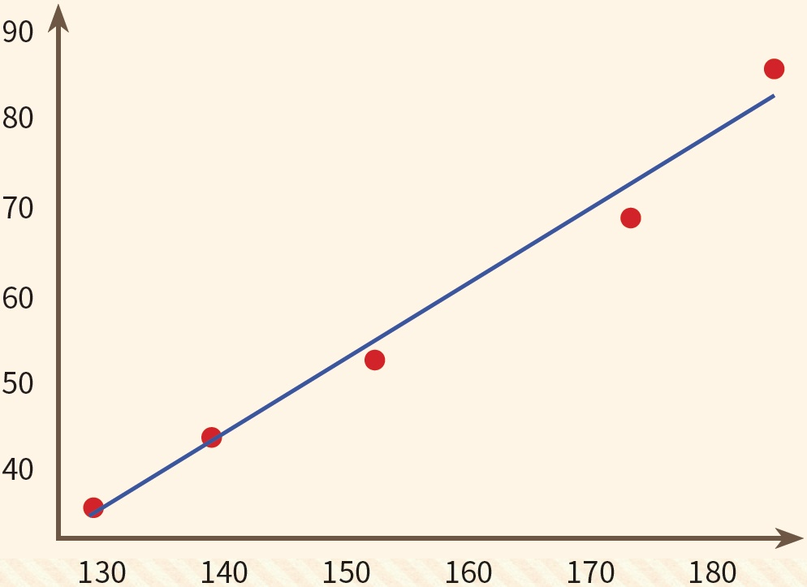
linear regression example
[67.30998637]

Slide 28
Overfitting vs Underfitting
Overfitting is creating a model that performs well on the data it is being trained on, but performs poorly on new data ( generalization ) .
Underfitting is when a model performs poorly on the training data . In this case, the model itself is often not suitable . We need to find a better model .

Slide 29
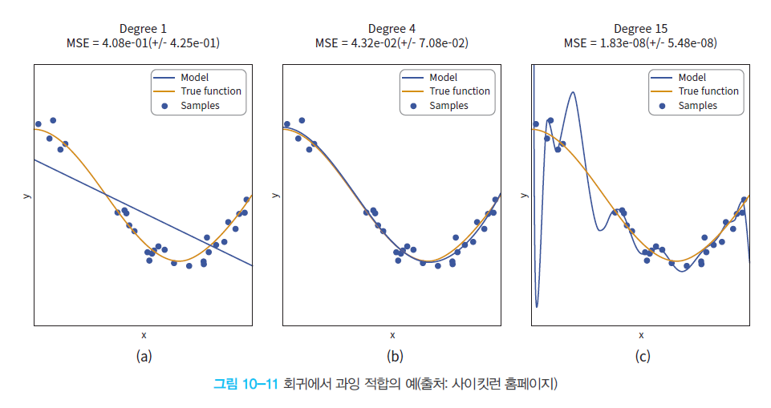
Overfitting vs Underfitting

Slide 30
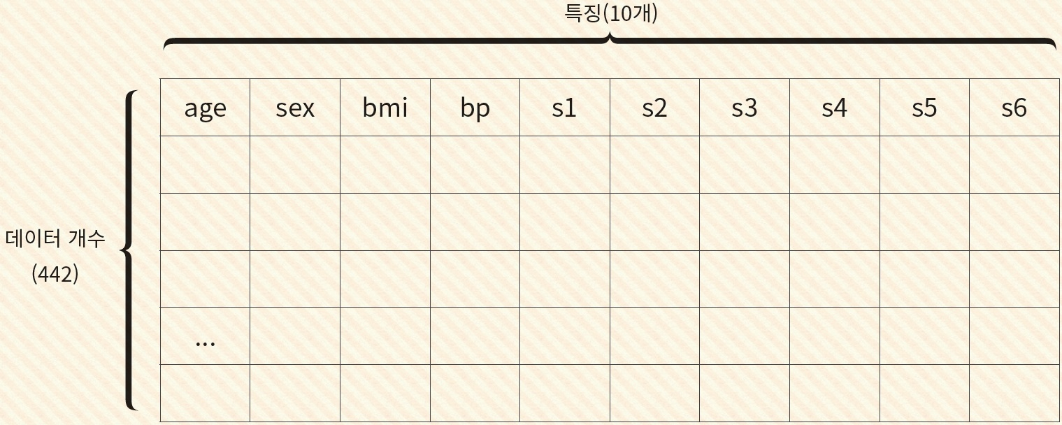
Lab: Diabetes Example
sklearn Data of diabetic patients are basically included in the library .

Slide 31
diabetes example
import matplotlib.pylab as plt
import numpy as np
from sklearn.linear_model import LinearRegression
from sklearn import datasets, linear_model
# Load the diabetes data set .
diabetes_X , diabetes_y = datasets.load_diabetes ( return_X_y = True )
diabetes_X_new = diabetes_X [:, np.newaxis , 2 ]
# Separate training and test data .
from sklearn.model_selection import train_test_split
X_train , X_test , y_train , y_test = train_test_split ( diabetes_X_new , diabetes_y , test_size = 0.1 , random_state = 0 )
regr = linear_model.LinearRegression ()
regr.fit ( X_train , y_train )
# Let's predict with test data .
y_pred = regr.predict ( X_test )
plt.scatter ( X_test , y_test , color = 'black' )
plt.plot ( X_test , y_pred , color = 'blue' , linewidth = 3 )
plt.show ()

Slide 32
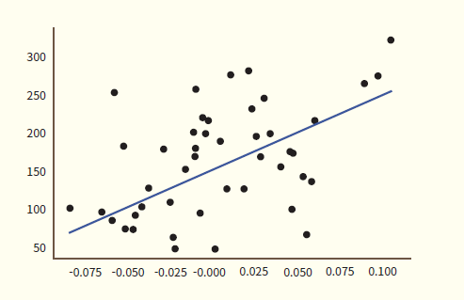
execution result

Slide 33
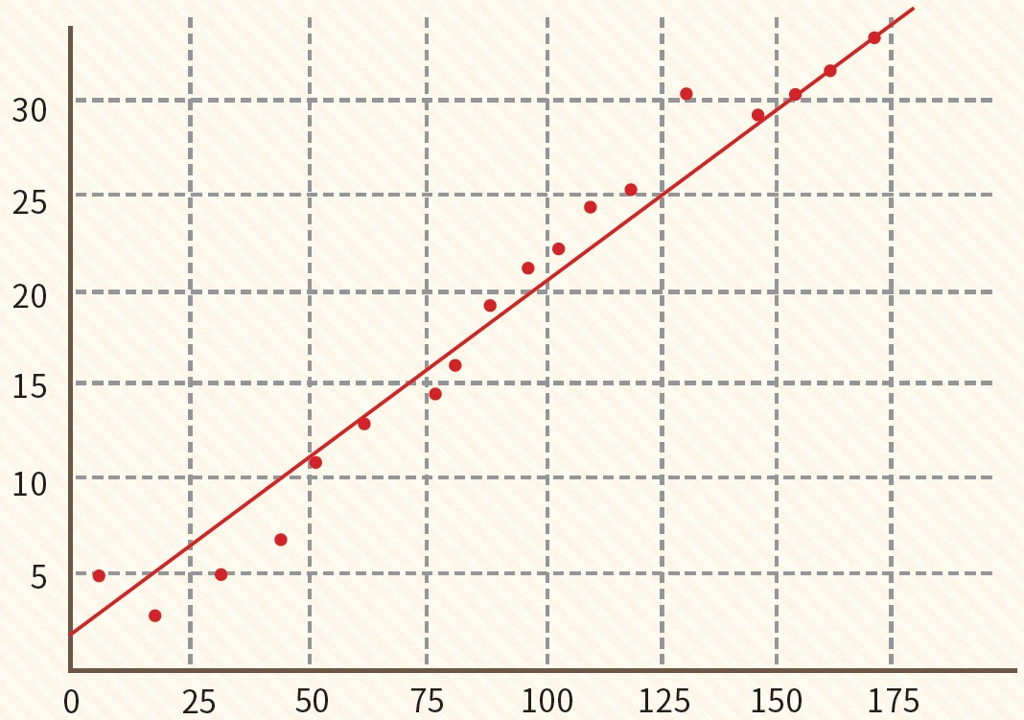
Open Lab: House price prediction by area
Let's create a system that outputs the price of an apartment when the user enters the area of the apartment . Since both the apartment area and price are real numbers, linear regression should be used among machine learning methods.

Slide 34
Summary
There were regression and classification in supervised learning . The former predicts continuous values and the latter predicts an input into one of some categories .
is the problem of finding the slope and intercept of the straight line that best describes the input data .
The loss function is the square of the difference between the actual data and the straight line .
In order to know the direction in which the value of the loss function decreases , methods such as the gradient descent method are commonly used .

Slide 35
Q&A

